Slide 1
SPEF Extraction
Maram Abbas 900153570
Youmna Sabik 900160339
Tasneem Elmaasrawy 900163075
GH: https://github.com/maram-abbas/LEF-AND-DEF-TO-SPEF

Slide 2
Input Files
.lef file
Capacitance of metal layer
Edge capacitance of metal layer
Resistance of metal layer
Resistance of via layer
Width of metal layer
.def file
Names of components
All info in nets section
.lib file
Capacitance of all pins
Direction of all pins

Slide 3
LEF Parser
Class ﻿LefParser
Ready-made from online source
Some additional parts added to the parser including:
Extracting edge capacitance of metal layers
Extracting resistance of metal layers
Extracting resistance of via layers
Referenced in slide 18

Slide 4
DEF Parser - 1
Class DefParser
Looped on components to get the cell names
Looped on the nets section to get the following:
Check whether net is a pin or not
Get which cells was it instantiated in and exact port
ROUTED Part:
Take this example: NEW metal2 ( 19200 27000 ) ( * 26800 ) M3_M2
X1 and y1 is 19200 and 27000 respectively
(x1,y1)(*, y2) the * value is same as x1 which is the same case as the above example
(x1,y1)(x2, *) the * value is same as y1
Extracts metal layer (metal2)
Extracts via (M3_M2)

Slide 5
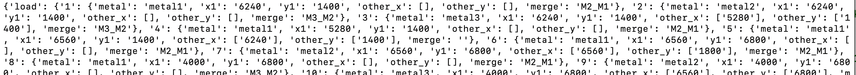
DEF Parser - 2
Pins stored in list called pin_name
Nets stored in list called nets
Names of each component stored in list called components_name
Each component is stored in list called components_cell
A dictionary named metal was used to store each line in the ROUTED section in the same order it was found in the DEF file.
Another dictionary named net_cell_instance stores data shown in each line in the COMPONENTS section.

Slide 6
LIB Parser - 1
Class LibParser
Looped on all cells (not only the ones in the DEF file)
Extracted the direction of each pin in a cell
If pin is an input, direction is I
If pin is an output, direction is O
Extracted equivalent capacitance of each pin as well

Slide 7

LIB Parser - 2
Direction stored in a list named direction
Name of cell stored in a list named cell_name
Name of the name stored in a list named pin
Capacitance of each pin is stored in a list named capacitance

Slide 8
SPEF Extraction - 1 (sections)
SPEF file includes:
Cell names
Nets
Each of these are referred to as a specific index
Put under NAME_MAP
Example: *1
Connections of each pin
Capacitance in each pin RC circuit
Resistance in each pin RC circuit

Slide 9
SPEF Extraction - 2 (capacitance calculation)
Loop on route section of DEF file to get total capacitance
For each, this equation is used:
CPERQDIST is from LEF
EDGECAPACITACE is from LEF
L is from DEF
W is from LEF

Slide 10
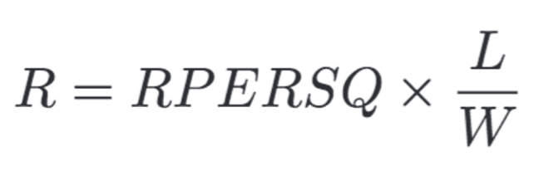
SPEF Extraction - 3 (resistance calculation)
Loop on route section of DEF file to get total resistance
For each, this equation is used:
RPERSQ is from LEF
L is from DEF
W is from LEF

Slide 11
Test Cases
DEF:
spi_master.def
o8_cpu.def
LEF:
osu018_stdcells.lef
LIB:
osu018_stdcells.lib
SPEF:
spi_master.spef
o8_cpu.spef

Slide 12
HOW TO RUN?
Open terminal to the directory where all your files are found
Make sure you have python installed since the source code of this project is written in python
Write on the terminal the following:
python gen_spef.py [def_path] [lib_path] [lef_path] [spef_path]
Check spef file for output

Slide 13
1st Test: spi_master
+ ROUTED metal2 ( 5120 -199 ) ( * 200 ) M3_M2
NEW metal3 ( 5120 200 ) ( 5600 * ) M3_M2
NEW metal2 ( 5600 200 ) ( * 800 ) M2_M1
NEW metal1 ( 5600 800 ) ( * 850 ) ;
Length | cpersqdis | width | Edge capacitance | Rpersq | Res_via | capacitance | Resistance
390 | 1.9 *10^-5 | 0.3 | 6*10^-5 | 0.08 | 0.3 | 0.025623 | 104
480 | 1.3 *10^-5 | 0.3 | 5.4*10^-5 | 0.08 | 0.3 | 0.027792 | 128
600 | 1.9 *10^-5 | 0.3 | 6*10^-5 | 0.08 | 0.3 | 0.03942 | 160
50 | 3.8 *10^-5 | 0.3 | 8*10^-5 | 0.08 | 0.3 | 4.57*e^-03 | 13.3

Slide 14
2nd Test: o8_cpu
- _954_
( AND2X2_6 A )
( NAND3X1_24 C )
( AOI22X1_7 Y )
+ ROUTED metal1 ( 9920 31400 ) M2_M1
NEW metal2 ( 9920 31400 ) ( * 31200 ) M3_M2
NEW metal3 ( 9920 31200 ) ( 10720 * ) M3_M2
NEW metal2 ( 10720 31200 ) ( * 31400 ) ( 11040 * ) M2_M1
NEW metal1 ( 9440 30800 ) M2_M1
NEW metal2 ( 9440 30800 ) ( * 31200 ) M3_M2

Slide 15
Length | cpersqdis | width | Edge capacitance | Rpersq | Res_via | capacitance | Resistance
- | - | - | - | - | 0.1 | 0 | 0
200 | 1.9*10^-5 | 0.3 | 6*10^-5 | 0.08 | 0.08 | 0.01314 | 53.3
800 | 1.3*10^-5 | 0.3 | 5.4*10^-5 | 0.08 | 0.08 | 0.04632 | 213.3
200 | 1.9*10^-5 | 0.3 | 6*10^-5 | 0.08 | - | 0.01314 | 53.3
320 | 1.9*10^-5 | 0.3 | 6*10^-5 | 0.08 | 0.1 | 0.021024 | 85.33
- | - | - | - | - | 0.1 | 0 | 0
400 | 1.9*10^-5 | 0.3 | 6*10^-5 | 0.08 | 0.08 | 0.02628 | 106.67

Slide 16
Testing - Resizer
In order to check the syntax of the .spef file generated, we used Resizer
We used Docker to run Resizer
Steps were as follows:
Create a volume with all your test files on it
Install Resizer on that volume and run it
Simply, while Resizer is running:
Check the .spef file by the command
read_spef [spef_name]
If it passed successfully and the syntax is right, it will return 1.
If not and the syntax is wrong, it will return 0 and tells you which line it expects the syntax is wrong on
Referenced in slide 18

Slide 17
Limitations
Our main limitation is checking the correctness of the data in the .spef file
We were able to check for the correctness of the syntax using Resizer
However, we tried as much as possible to the the correctness of the data by doing several random calculations and checking them manually.

Slide 18
Group Dynamics
Maram Abbas:
DEF Parser
Added part to LEF Parser
SPEF Extraction - resistance calculation
Testing
Youmna Sabik:
Lib Parser
SPEF Extraction - resistance calculation
Testing
Tasneem Elmaasrawy:
SPEF Extraction - capacitance calculation
SPEF Extraction - resistance calculation
Testing
Note: We all gathered for major understandings.

Slide 19
References
LEF Parser: https://github.com/trimcao/lef-parser
Resizer: https://github.com/The-OpenROAD-Project/Resizer

